Slide 1
Decentralized Training Seminar Session - I Fundamentals
For Reference Only
Facilities Planning and Scheduling
Fall 2015 Sessions
Banner 8.5

Slide 2
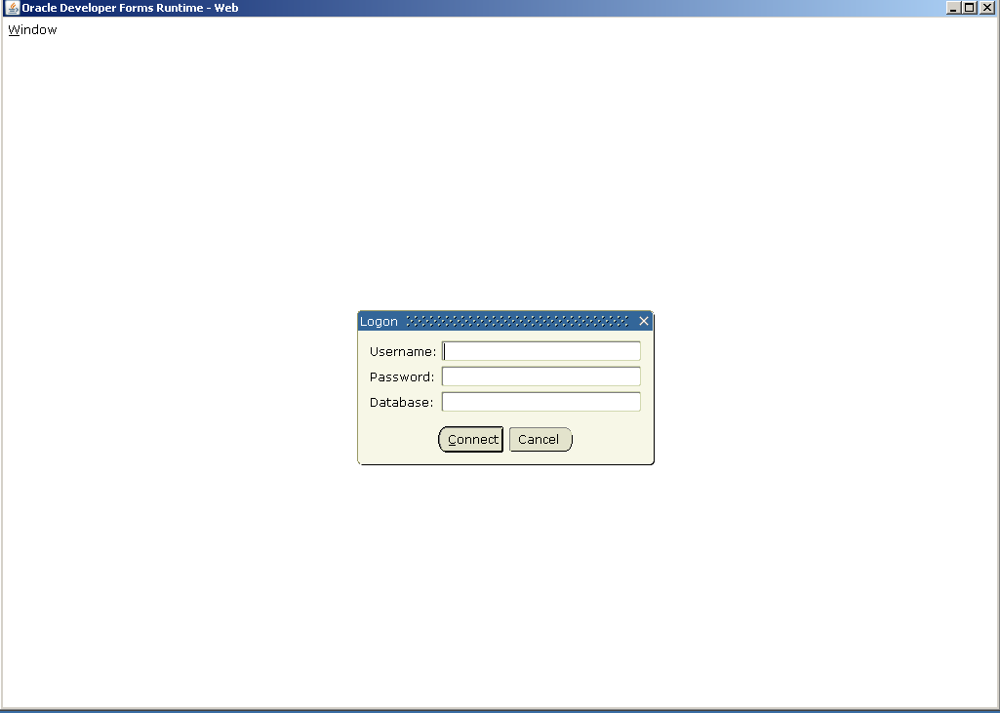
Production Banner Access:
Log on To Banner
http://staraccess.wvu.edu
Username:
Master ID / Password
Database:
Star
Test Banner:
http://starlinks.wvu.edu/
Database:
Starptch
For Reference Only
West Virginia University Facilities Planning and Scheduling

Slide 3
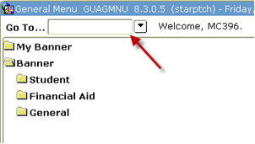
Workscreens
Navigating through
Save and Next Block
Rollback and Previous Block
Remove Record
SSASECT
- Main Screen
- 90% of Changes
- Add new section
SSATEXT
Course comments
SSARRES
Course restriction
For Reference Only
West Virginia University Facilities Planning and Scheduling
Notes:
“Save” and “Next Block”
“Save” will save the screen. Must perform this before moving on.
“Next Block” will go to the next Tab.
“Rollback” and “Previous Block”
“Rollback” will take you back to the beginning of the screen you are working on.
“Previous Block” will take you to the previous tab.
If you are unsure about what a button does, hold your cursor over the icon. Banner will provide a quick explanation.
Once in a screen, if you are unsure about the options, select the triangle beside the field.
Point out Field Definitions print out.

Slide 4
SSASECT work screen
Making Changes
Hiding a Course
Part of Term
Max Enrollment
Meeting Patterns
Instructor Add/Changes
Building/Room Assignment
Room Features
Restrictions
Course Comments
For Reference Only
West Virginia University Facilities Planning and Scheduling
Notes:
Begin exercises for making each change.
Will have each work on a small list of changes from subject codes of those in other session.

Slide 5
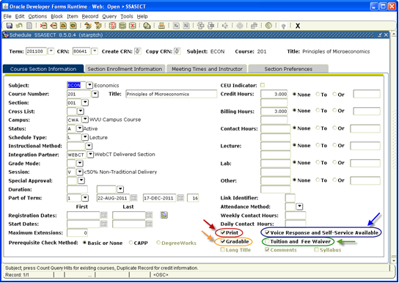
Hiding a Course
Enter HC: in Attendance Method box (hidden section)
Enter DA: in Special Approval box
(departmental approval)
Uncheck the Print and Voice Response Boxes.
To un-hide a section – reverse steps.
For Reference Only
Print Box
Voice Response and Service Box
MUST BE UNCHECKED TO HIDE COURSE from Web.
West Virginia University Facilities Planning and Scheduling
Notes:
Hiding a course: Used to hold a section open and active, but closed and unavailable for registration.
Print and Voice Response Boxes are what make it viewable and printable on the web for registrations *
Cannot hide a course after registration
UNHIDE = can do at any time of the semester
Remove DA – HC – make sure to Check Print and Voice Response Boxes
The Gradable box must always be checked (orange arrow), unless:
The course’s grading mode is set to ‘4’ – no grade.
The course has been cancelled.
The Tuition and Fee Waiver box (green arrow) should only be checked for courses that are tuition waived or have special billing needs.

Slide 6
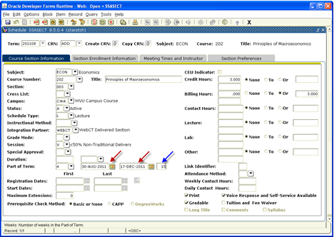
Course Section Information Tab
Part of Term
Always refer to POT Tables for each semester
http://facilitiesscheduling.wvu.edu/reference_information
Date populates automatically based on the code
POT Table has all dates available and is developed by the Registrar’s Office.
For Reference Only
West Virginia University Facilities Planning and Scheduling

Slide 7
Steps to Changing Part of Term before enrollment only
Remove instructor(s) – save
Remove meeting pattern(s) – save
Adjust POT code – save
Re-add meeting pattern(s) – save
Re-add instructor information(s) – save
Re-Add room features on Scheduler Preferences Tab (they are removed automatically with these changes)
Cannot change POT after Enrollment * No Exceptions *
Section must be Canceled by Scheduling
For Reference Only
West Virginia University Facilities Planning and Scheduling
Notes:
Take time to get it right the first time to avoid all of these changes.
Course muse be cancelled and re-added if need to change POT after enrollment.
If arranged POT – must also match Census One Freeze Date on Section Enrollment Information Tab

Slide 8
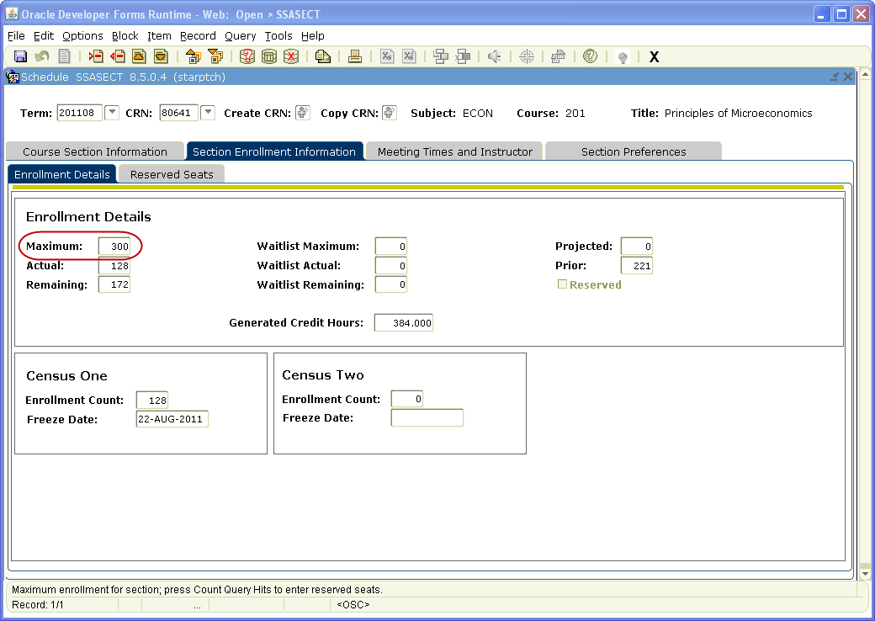
Section Enrollment Information Tab
Max Enrollment
Enrollment Details tab
Maximum field
Enter total number of students to enroll
Max Enrollment Must NOT exceed Room Capacity
Do not use or change Reserved Seats tab
For Reference Only
West Virginia University Facilities Planning and Scheduling
Notes:
Must ignore reserved seating tab (no access)
Cannot have negative enrollment in remaining field where Actual exceeds max enrollment.
Cannot register online after first day of classes – students have 1st week of school to register in person.
Max enrollment always rolls over to next semester if not corrected.

Slide 9
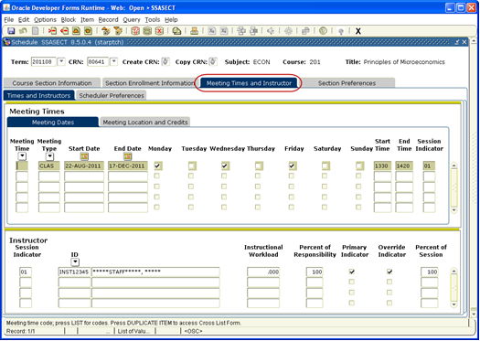
Meeting Times and Instructor / Meeting Dates
Meeting Patterns
Populates automatically from part of term date by hitting TAB key
Start & End Times must be 4 digit military time
Cannot end a section on the hour or ½ hour
For Reference Only
West Virginia University Facilities Planning and Scheduling
Notes:
Dates populate automatically from the POT set on first page or from rollover
Populate by tabbing over
Select days course will meet
Times must be military time (4 digit number) – Cannot end on the hour or half hour.
Change at any time with out restriction
- except you can/will lose the room you already have assigned.

Slide 10
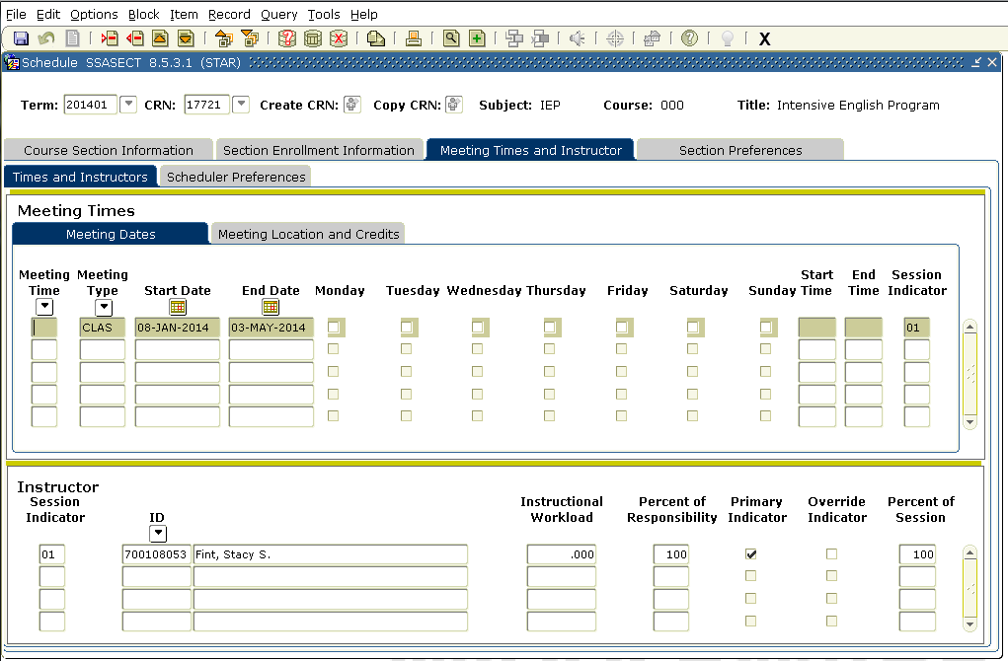
Meeting Times and Instructor Tab
Instructor Add / Changes
Name populates with valid WVU ID
Percent must always equal 100% for 1 or for multiple instructors
Cannot override Primary Instructor unless section is crosslisted.
For Reference Only
West Virginia University Facilities Planning and Scheduling
Notes:
Add Instructor 700#’s – Name populates automatically if # is correct
Error may occur if instructor scheduling conflict exists (later tab)
# of Responsibility 0 -100% must equal Percent of Session
Must Check:
- Primary Indicator only if main instructor
Override indicator if not primary instructor and more than one instructor to be listed
INST12345 – if no instructor listed “staff” – always 100% and must check all
Can change anytime after enrollment (HEPC- Must have actual instructor listed to course by 1st week of classes – if not than School Dean/Assoc Dean name will be assigned)

Slide 11
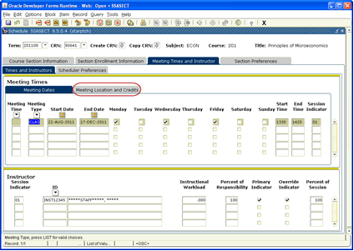
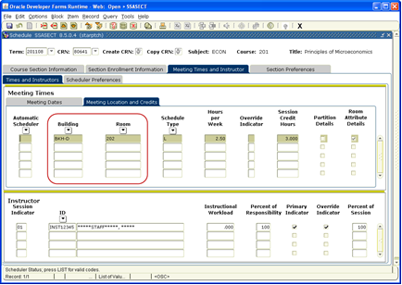
Meeting Times and Instructor Tab
Building / Room Assignments
Meeting Locations and Credits Tab
Building
Room
Cannot Assign General Purpose Space in Banner
General Purpose Rooms must be requested through Scheduling – No Exceptions.
If Schedule Type is Web, Building must say ONLINE
For Reference Only
West Virginia University Facilities Planning and Scheduling
Notes:
Can only schedule Departmental Spaces – General purpose classrooms are done by us(FPS)
D - Downtown Campus
E – Evansdale Campus
Can change after enrollment (Discouraged due to heavy duty student schedule implications)

Slide 12
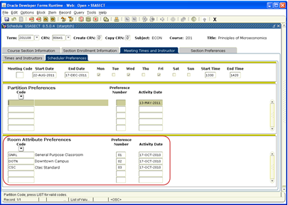
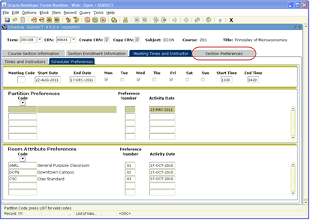
Preference numbers can only be used for required group:
Room Features
Scheduler Preferences Section Preferences
01- Classroom
GNRL, DPRT,
NORN
02 - Campus
DOTN, EVDL, HSC
03 - Technology
DTLO (Department Tech), IDSC (iDesign Standard), IDCL (iDesign Computer Lab), PLUG (iDesign Plug-N-Play)
04 – Optional
MOVS, CHAB, EXAB,
WHIB
NORN for all Academic Innovation courses
For Reference Only
West Virginia University Facilities Planning and Scheduling

Slide 13
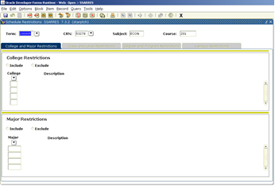
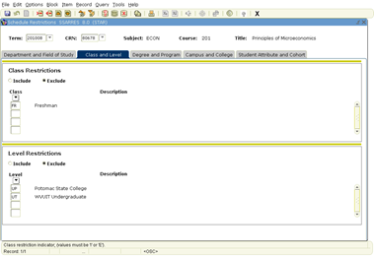
SSARRES work screen
Adding Restrictions
Can Only Restrict
Major
Class
College
Level
Can only
Include or Exclude
Major and College Codes are unique to department
Major
For Reference Only
Class & Level
College
West Virginia University Facilities Planning and Scheduling
Notes:
College and Major restrictions should not be mixed unless the department wants to make a course include a specific college but also wants to exclude a specific major in that college.
Example:
A department may decide that they want to make a course include all college code 14 (Art and Sciences), but want to exclude major code 1442 (English).
There should never be “include major” and “include college” on the same course. Major restrictions alone will take care of it.
Major Restriction is most restrictive
If you think it will need it, Add it. It is easier to take off than to Add on – after enrollment.

Slide 14
SSARRES Work Screen
Restrictions After Enrollment
Remove ALL or NONE for that one group of restrictions.
Cannot add after enrollment
Section must be canceled and re-added with correct restriction code.
ONLY scheduling can cancel a section.
You will have to re-add the new section with correct restriction codes – let Scheduling know of new CRN to include in cancelation email to students.
Major Restrictions are the most specific to use
Decide WHO you want to let in; WHO you want to keep out
For Reference Only
West Virginia University Facilities Planning and Scheduling
Notes:
Only Restrict
Major
Class
College
Level
* Remove ALL or NONE
* If it needs added after enrollment – must cancel course
* Category Specific
- Always ADD a higher level of restriction if you think you will need it
Easier to take off than to Add on
College and Major restrictions should not be mixed unless the department wants to make a course include a specific college but also wants to exclude a specific major in that college. Example: A department may decide that they want to make a course include all college code 14, but want to exclude major code 1442. There should never be “include major” and “include college” on the same course. Major restrictions alone will take care of it.

Slide 15
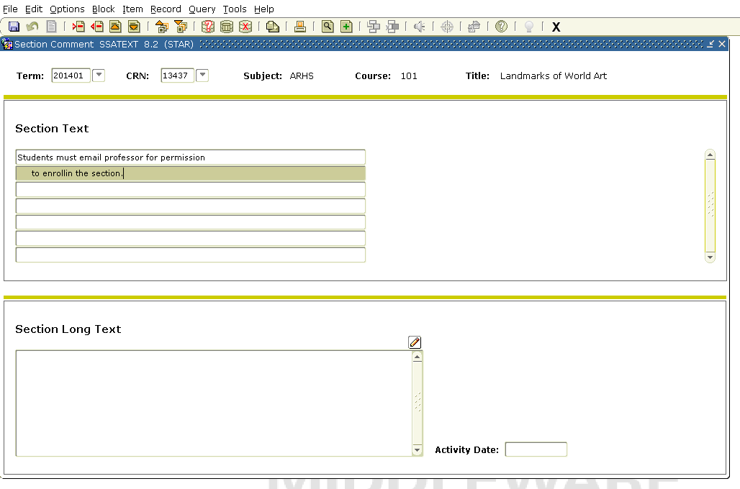
SSATEXT Work screen
Section Course Comments
Access through work screen or Options Menu from SSASECT
Begin to write message to students in first line.
Second and subsequent lines must be indented 2 spaces before typing.
Comments will be specific to the section being written for.
For Reference Only
West Virginia University Facilities Planning and Scheduling

Slide 16
Changes After Enrollment
Allowed…
Not Allowed…Must Cancel
Change “POT” - Part of Term
Change Credit/Bill Hours
Change Course Title
Change Schedule Type
Add “DA” – Departmental Approval (Can Remove)
Hide a Course
Add Restrictions
Change/Add the Grade Mode
Change Tuition Waived Box
Link Lectures with non-graded Labs or Recitations
Add or Remove WEBOC
Meeting Pattern
Change Max Enrollment
Change Instructors (add/delete)
Change Course Section Comments
Assign own Departmental Building/ Rooms
For Reference Only
West Virginia University Facilities Planning and Scheduling
Notes:
Max Enrollment
room capacity must accommodate new enrollment
Meeting Time Changes
go to SFASLST to get student information and notify them of the changes
Instructor adding / removing
Course section comments
Assign own Departmental Building / Room
Assignments
gnrl purpose classrooms through FPS
Restrictions
Remove
ALL or NONE – Per Restriction group
Remove Departmental Approval
Cannot Add “DA” after enrollment

Slide 17
Decentralized Training Seminar Session - II Adding New Sections
For Reference Only
Facilities Planning and Scheduling
Fall 2015 Sessions
Banner 8.5

Slide 18
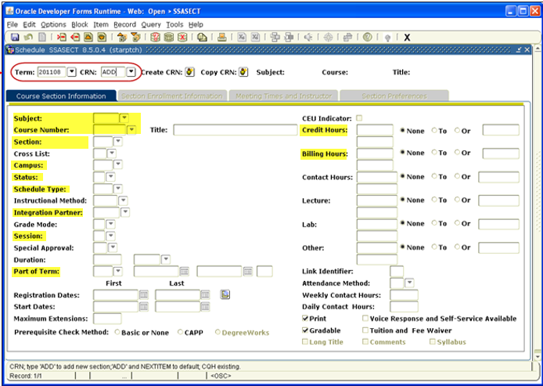
SSASECT Work screen
Adding New Sections
Required Information to generate CRN.
Information on subsequent tabs must be completed to validate added section.
Enter Semester
CRN = ADD
For new screen
Use TAB to move
Not active until you hit SAVE and entered info on all tabs
Credit and Bill Hours must match (populate from catalog)
Flexible title sections must be assigned by Registrar’s Office
For Reference Only
West Virginia University Facilities Planning and Scheduling
Notes:
Info Needed:
Semester
2013-?
Subject Code
Course Number
Section Number
Campus Code
Status
Schedule Type
Integration Partner (WEBCT)
Part of Term Code
Credit/Bill Hours

Slide 19
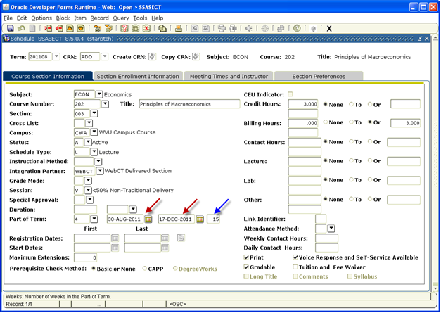
Adding a new section
Special Notes
Permanent Course Titles come from Catalog
DO NOT CHANGE
* Flexible Titles must be requested through Registrar’s Office *
Campus Code
CWA = All courses
Instructional Method:
WEBOC if Academic Innovation
Integration Partner
Always = Blank as of Spring 2017
For Reference Only
Credit/Bill Hours = Fixed or Variable
Populates automatically from Catalog
Can fix at the section level only if variable option given
West Virginia University Facilities Planning and Scheduling

Slide 20
Required Information Details
Section Number - 3 Characters
On campus = 001/002 etc..
Ext. Learn = 7D1 etc…
Honors = H01
W or C = Writing or Capstone – must already be designated at Catalog Level, cannot make on your own
Campus Code
CWA for ALL Sections
Instructional Method – Academic Innovation ONLY
WEBOC
Status
A = Active
Schedule Type
L = Lecture / B = Laboratory / G = Graded Lab / W = Web Based / R = Recitation
Integration Partner Always blank
Session Code – See next page.
Part of Term Codes – See POT Table for term needed. Assigned by Registrar’s Office.
Credit/Bill Hours
- Cannot change fixed credit hours
- Billing hours will almost always equal credit hours
Variable Credit/Bill hours
* If variable and want to offer a fixed amount with in given range, bill hours must equal that fixed amount
For Reference Only

Slide 21
Session Code- UPDATE
Due to HEPC Reporting the Session Code entry will change starting Fall 2014 for adding new sections
1 = 100% Non-Traditional Delivery (Old X)
5 = < 50% Non-Traditional Delivery (Old V)
6 = 50 - 74% Non-Traditional Delivery
7 = 75 - 99% Non-Traditional Delivery
For Reference Only

Slide 22
Campus Code - UPDATE
For ALL Sections – Starting FALL 2015
Campus Code will be CWA – for all sections including Academic Innovation sections
Academic Innovation sections will be identified by:
Section Number (7D1, 7D2...)
Instructional Method - must now enter WEBOC (Web Off Campus)
All sections will need to have NORN added to room features on both required tabs

Slide 23
For Decentralized Reference Information:
For Reference Only
http://facilitiesscheduling.wvu.edu/
West Virginia University Facilities Planning and Scheduling

